Slide 1




LOW HOPE PROJECT
FPT University
Hanoi, December 22th 2017

Slide 2

Project Members
Supervisor
Mr.Tran Binh Duong
Tran Hong Quan
Le Duy Cong
Nguyen Huy Phong
Project Manager
Team Member
Team Member
Nguyen Van Vinh
Nguyen Thanh Tung
Team Member
Team Member

Slide 3
OUTLINE
Introduction
Project management
Requirement specification
Software Design
Testing
Limitations
Lesson learned
Demo - Q&A

Slide 4

1
Introduction
2
Project management
3
Demo - Q&A
Requirement specification
4
Software Design
5
Testing
6
Limitations
7
Lesson learned
8
In the world today, the electronic cash market is growing.
The most popular electronic cash is bitcoin.

Slide 5
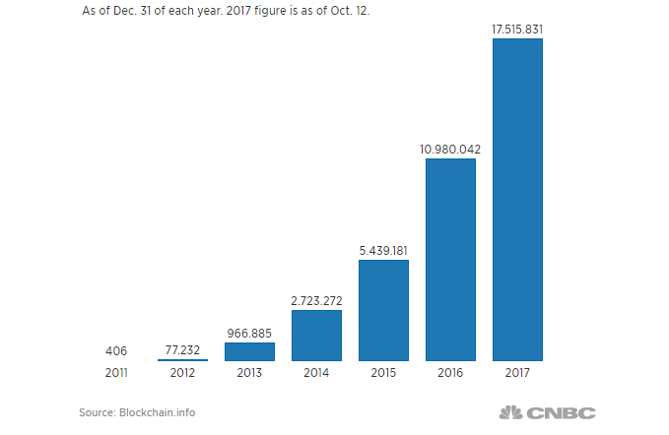
1
Introduction
2
Project management
3
Demo - Q&A
Requirement specification
4
Software Design
5
Testing
6
Limitations
7
Lesson learned
8
- One way to evaluate object interested in bitcoin is observing major growth of the number of wallet used by investors to store their bitcoin.

Slide 6
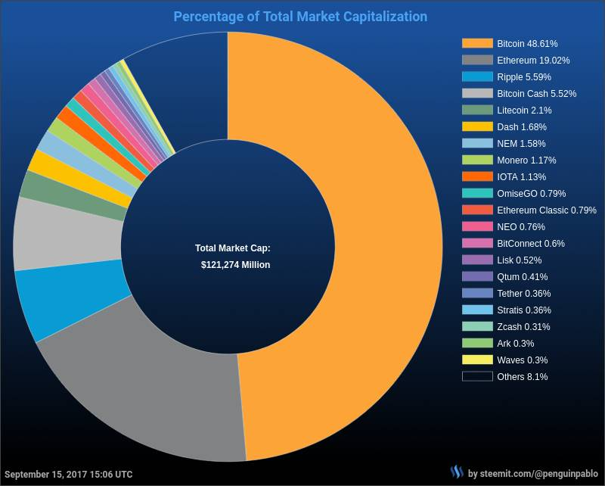
1
Introduction
2
Project management
3
Demo - Q&A
Requirement specification
4
Software Design
5
Testing
6
Limitations
7
Lesson learned
8

Slide 7
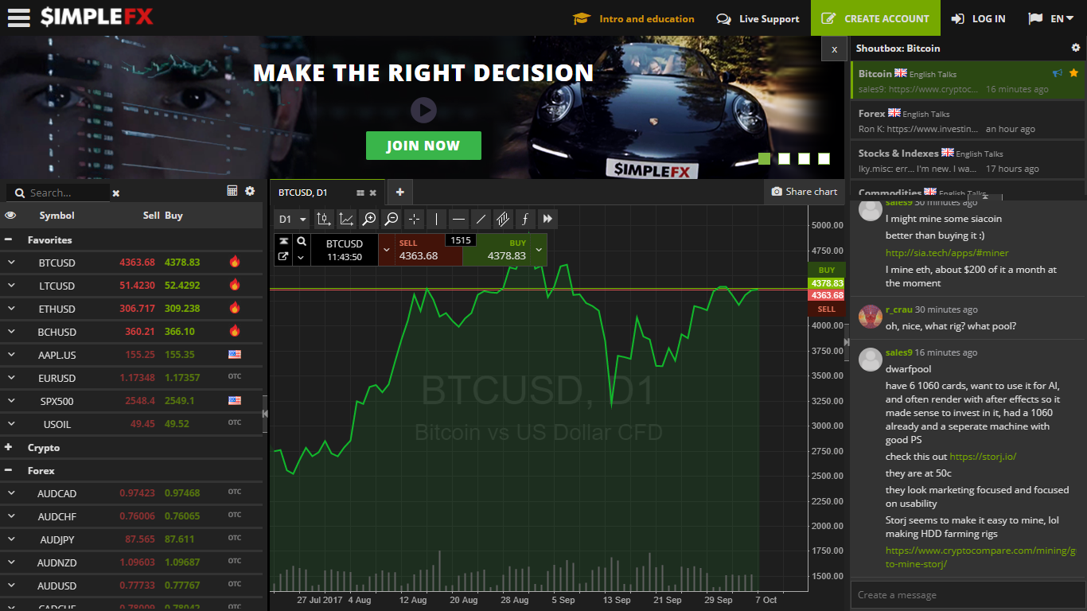
Existed system
1
Introduction
2
Project management
3
Demo - Q&A
Requirement specification
4
Software Design
5
Testing
6
Limitations
7
Lesson learned
8
SIMPLEFX

Slide 8
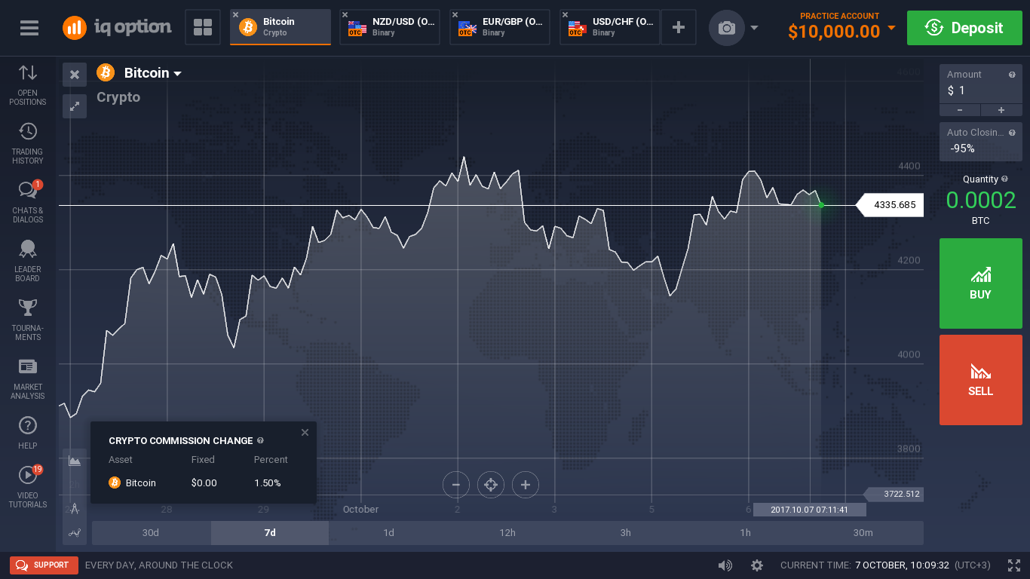
Existed system
1
Introduction
2
Project management
3
Demo - Q&A
Requirement specification
4
Software Design
5
Testing
6
Limitations
7
Lesson learned
8
IQOPTION

Slide 9
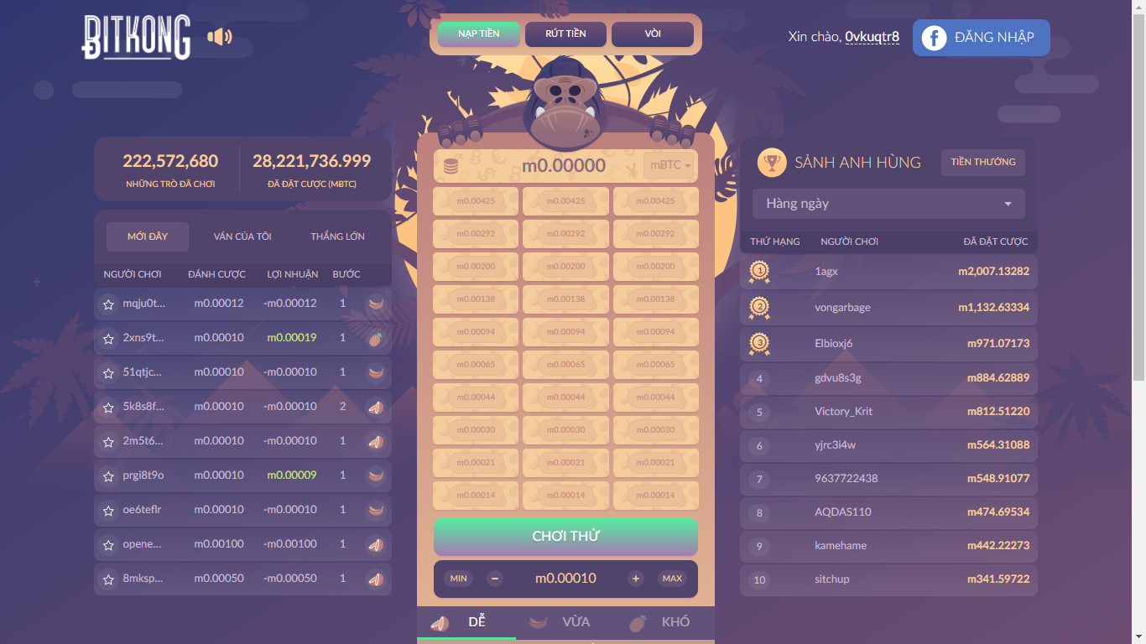
Existed system
1
Introduction
2
Project management
3
Demo - Q&A
Requirement specification
4
Software Design
5
Testing
6
Limitations
7
Lesson learned
8
BITKONG

Slide 10
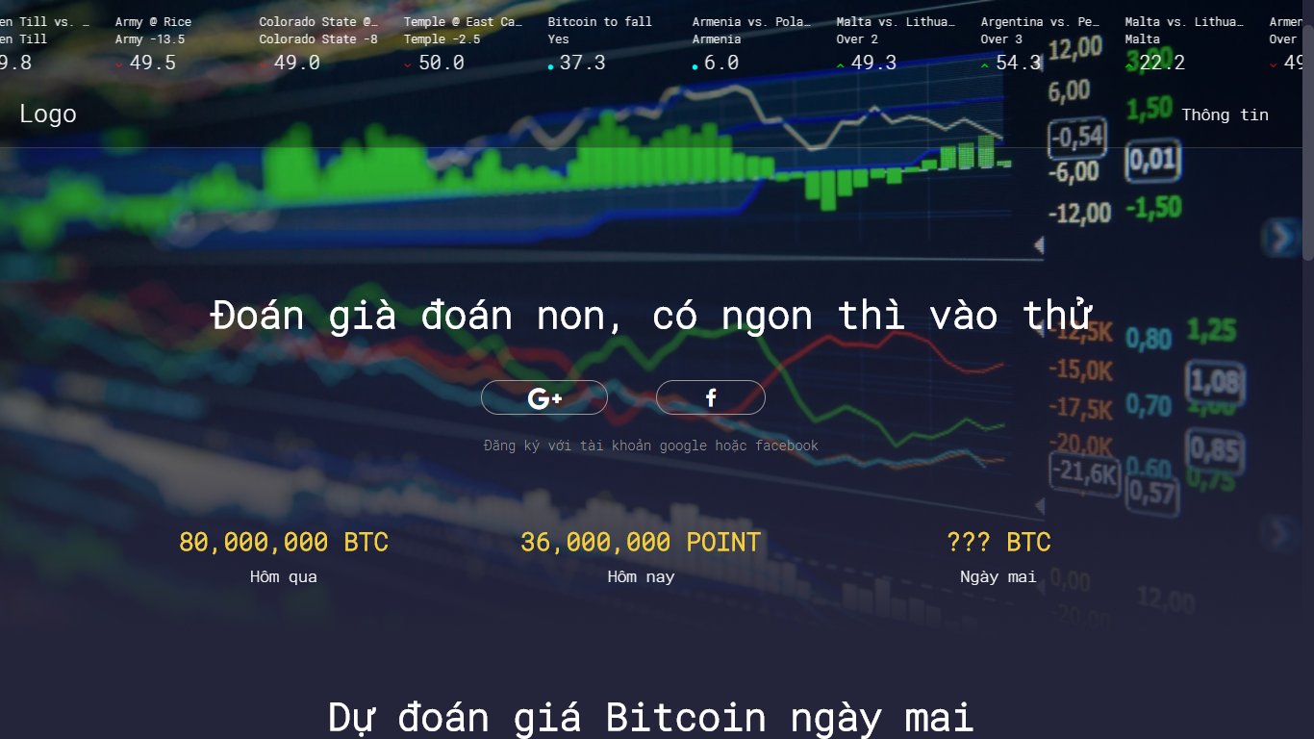
Our Proposal
1
Introduction
2
Project management
3
Demo - Q&A
Requirement specification
4
Software Design
5
Testing
6
Limitations
7
Lesson learned
8
LowHope

Slide 11
Our Proposal
1
Introduction
2
Project management
3
Demo - Q&A
Requirement specification
4
Software Design
5
Testing
6
Limitations
7
Lesson learned
8
LowHope
* Traditional bitcoin betting game.
This game is played once a week.
Player estimate bitcoin price at specific time.
Winner of this game will receive attractive prizes.
* Yes or No betting game.
Allows the player to make bitcoin betting game, exchange with answer Yes - No.
Winner of this game will receive points to play traditional betting game.
Multiple choice betting game.
Allows players to create multiple choice games about bitcoin prices.
Winner of this game will receive points to play traditional betting game.

Slide 12
1
Introduction
2
Project management
3
Demo - Q&A
Requirement specification
4
Software Design
5
Testing
6
Limitations
7
Lesson learned
8
Objectives
Process model
Project planning
Tools & Technologies
Communication management
Risk management

Slide 13
1
Introduction
2
Project management
3
Demo - Q&A
Requirement specification
4
Software Design
5
Testing
6
Limitations
7
Lesson learned
8
Objectives
Define the specific roles of the project team members
This project must be completed task on time and finished no later than 13/12/2017
Covers 100% of requirements
The 5 team members study new technology and new skills about develop application, working in group.
Team members have chance to work in working environment that same as realistic environment

Slide 14
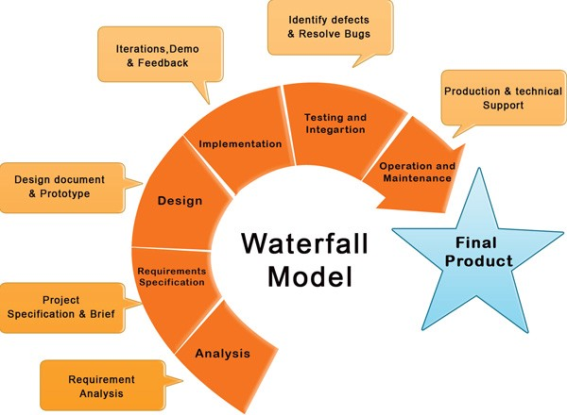
1
Introduction
2
Project management
3
Demo - Q&A
Requirement specification
4
Software Design
5
Testing
6
Limitations
7
Lesson learned
8
Process model

Slide 15
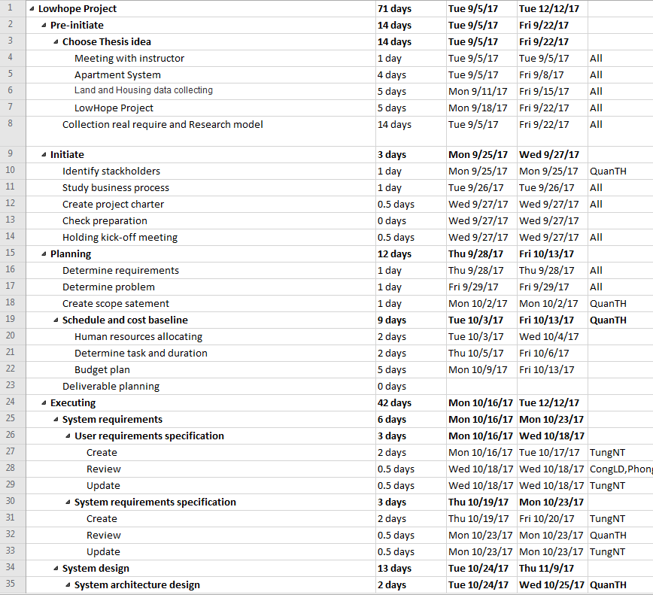
1
Introduction
2
Project management
3
Demo - Q&A
Requirement specification
4
Software Design
5
Testing
6
Limitations
7
Lesson learned
8
Project planning

Slide 16
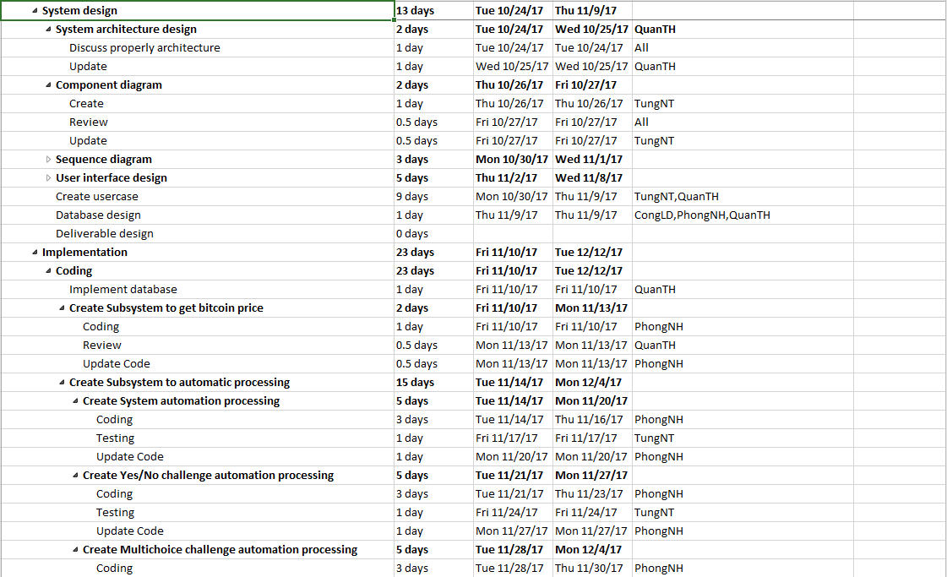
1
Introduction
2
Project management
3
Demo - Q&A
Requirement specification
4
Software Design
5
Testing
6
Limitations
7
Lesson learned
8
Project planning

Slide 17
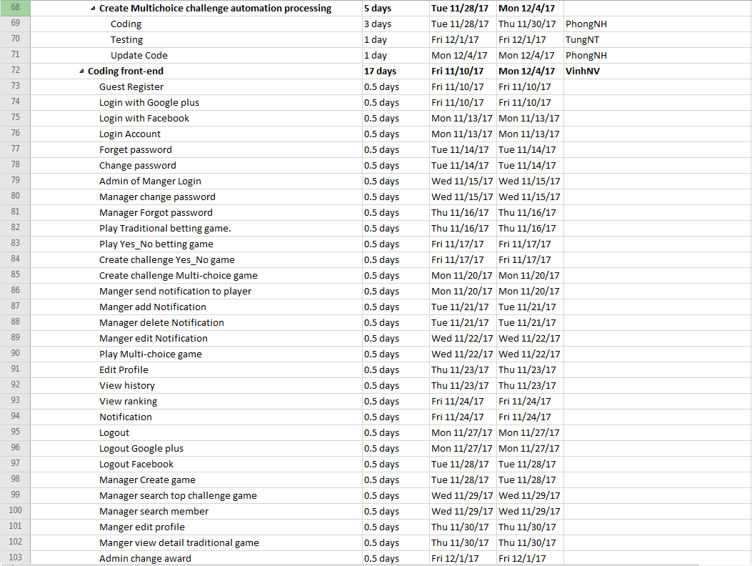
1
Introduction
2
Project management
3
Demo - Q&A
Requirement specification
4
Software Design
5
Testing
6
Limitations
7
Lesson learned
8
Project planning

Slide 18
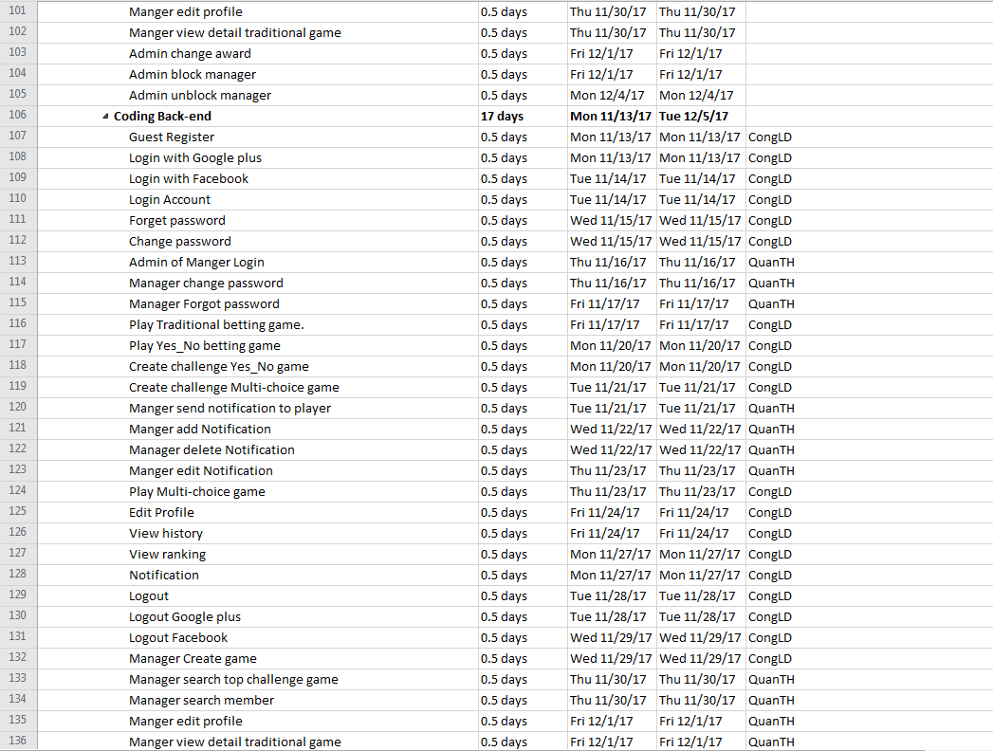
1
Introduction
2
Project management
3
Demo - Q&A
Requirement specification
4
Software Design
5
Testing
6
Limitations
7
Lesson learned
8
Project planning

Slide 19
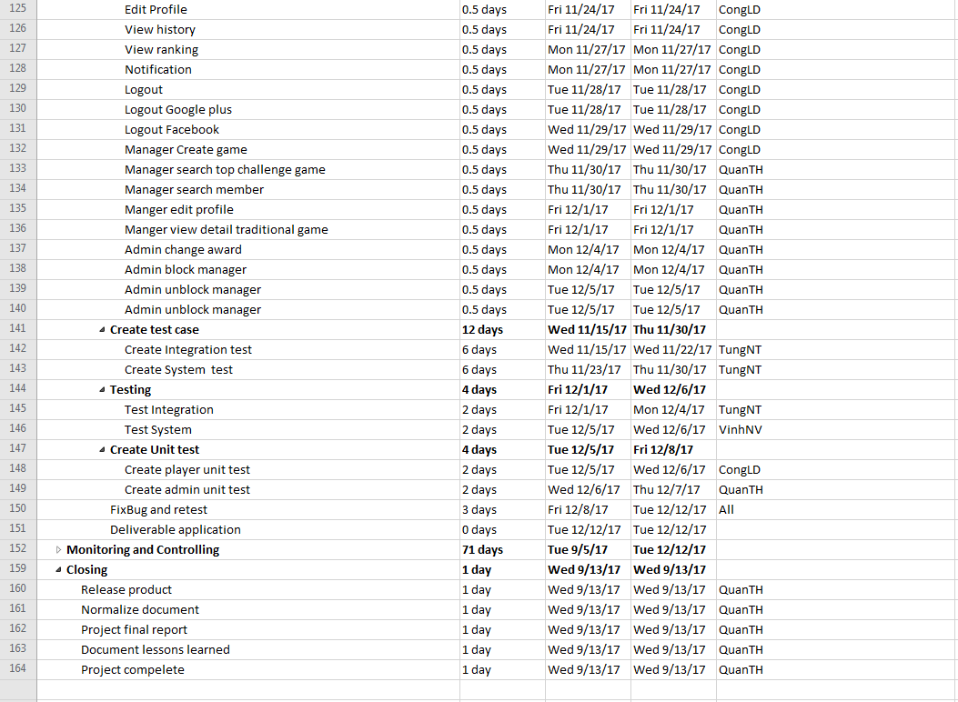
1
Introduction
2
Project management
3
Demo - Q&A
Requirement specification
4
Software Design
5
Testing
6
Limitations
7
Lesson learned
8
Project planning

Slide 20






1
Introduction
2
Project management
3
Demo - Q&A
Requirement specification
4
Software Design
5
Testing
6
Limitations
7
Lesson learned
8
Tools & Technologies
Document tools
Design tool
Project management tool

Slide 21






1
Introduction
2
Project management
3
Demo - Q&A
Requirement specification
4
Software Design
5
Testing
6
Limitations
7
Lesson learned
8
Tools & Technologies
Development tool
Source management tool
Web Browser

Slide 22






1
Introduction
2
Project management
3
Demo - Q&A
Requirement specification
4
Software Design
5
Testing
6
Limitations
7
Lesson learned
8
Tools & Technologies
Technologies

Slide 23




1
Introduction
2
Project management
3
Demo - Q&A
Requirement specification
4
Software Design
5
Testing
6
Limitations
7
Lesson learned
8
Tools & Technologies
Project teams have meeting 3 times per weeks
Meeting with supervisor every week
Began at 21/11, Project teams have work together at the same location

Slide 24
No | Risk Name | Description | Category | Probability | Avoidance Plan | Impact | Trigger
R1 | Team members lack technical skills and knowledge. | Team members are unable to complete work because they do not know how to do. | human | High | Person in charge of Development Team provides workshops and training sessions for developers to acquire needed knowledge and techniques. Encourage team members to study on themselves for their technical personal needs. Develop project plan with regards to training and self-study period. | High | Team members take a lot of time to do their task/Team member informed that they cannot do the task.
R2 | Team member conflict. They refuse to cooperate with each other | Team member disagree with each other and refuse to work. | human | High | Hold teambuilding activities to build team’s spirit. Create a friendly environment. | High | When somebody does not work because of disagreement
R3 | Change of requirement | The scope may change, unplanned requirements may get added | Requirement | Medium | Take time to brainstorm features carefully with all team members. Meticulously design system, take care of all possible situations to avoid changes. | High | When Supervisor or team member request to change requirement
R4 | User reject the product | Unfriendly GUI Large for downloading Application is not suitable with market trend | Requirement | Medium | Front-end leader must be design GUI for user’s convenience and easy to use. GUI design should be beautiful looking and easy to understand. Listen to users' complaint and find solution Conduct a market survey Follow coding construction | High | User complaint about the application
R5 | Absences of team members | Team member do not pay enough time for the project | Human | Medium | Provide meeting schedules and deadlines in advance so that all team members know the time and place where they will be needed PM should be warned immediately when team member plan to be absent for a period of time. Arrange team work frequently. Sketch deadline for the assigned tasks | High | Team members does not spend time for work and tasks are not completed on time
R6 | Lost data | Admin’s Computer is infected with virus resulting in data loss | Human | Low | Backup database automatically daily by using some Version Control Tools or Clouding Service | Medium
R7 | Lack of Supervisor support | Supervisor may have not enough time to support project team | Human | Low | You can meet supervisors after slot in class. Define a meeting schedule with Supervisor. Use communication medium effectively. Reference from other source. | Medium | It takes 2 day or more for mail response. Meeting with Supervisor is hard to arranged.
R8 | Schedule flaws | Time for one task may too long or too short Trouble may occurs during process that makes task longer than expected | Estimates | High | You must to set the correct time for each task so as not to delay the progress of project. Get to known team member skill. Use Microsoft Project tool. Add slack time for importance task | Medium | Somebody have much time to free and some did not finish their task on time
1
Introduction
2
Project management
3
Demo - Q&A
Requirement specification
4
Software Design
5
Testing
6
Limitations
7
Lesson learned
8

Slide 25
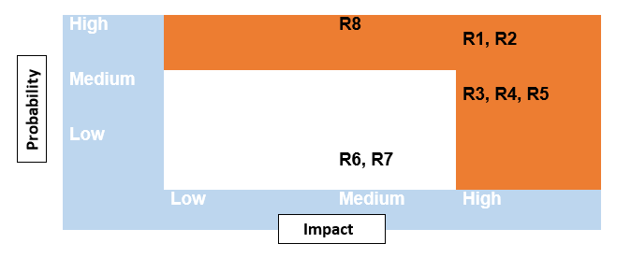
1
Introduction
2
Project management
3
Demo - Q&A
Requirement specification
4
Software Design
5
Testing
6
Limitations
7
Lesson learned
8
Risk management
Probability – Impact matrix

Slide 26
1
Introduction
2
Project management
3
Demo - Q&A
Requirement specification
4
Software Design
5
Testing
6
Limitations
7
Lesson learned
8
Overview of the system
Functional requirements
Non – functional requirements

Slide 27
1
Introduction
2
Project management
3
Demo - Q&A
Requirement specification
4
Software Design
5
Testing
6
Limitations
7
Lesson learned
8
Overview of the system

Slide 28
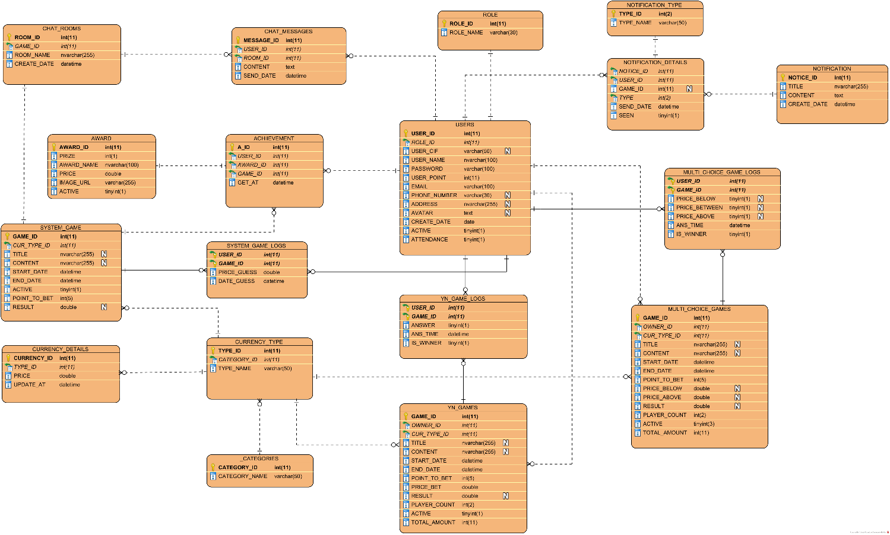
1
Introduction
2
Project management
3
Demo - Q&A
Requirement specification
4
Software Design
5
Testing
6
Limitations
7
Lesson learned
8
Database Design

Slide 29
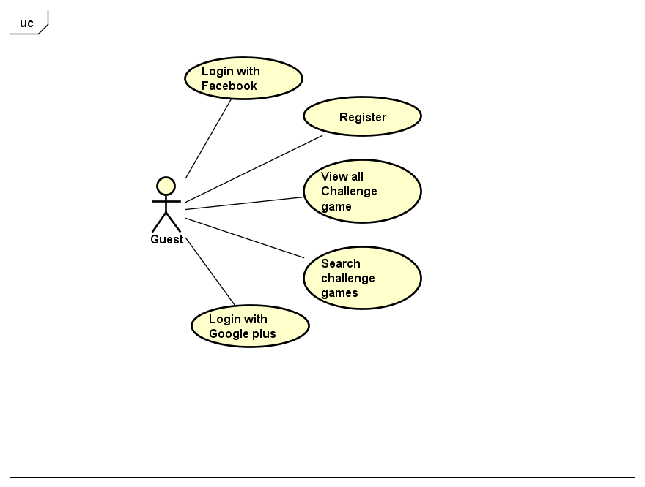
1
Introduction
2
Project management
3
Demo - Q&A
Requirement specification
4
Software Design
5
Testing
6
Limitations
7
Lesson learned
8
Functional requirements
User case level 1-Guest

Slide 30
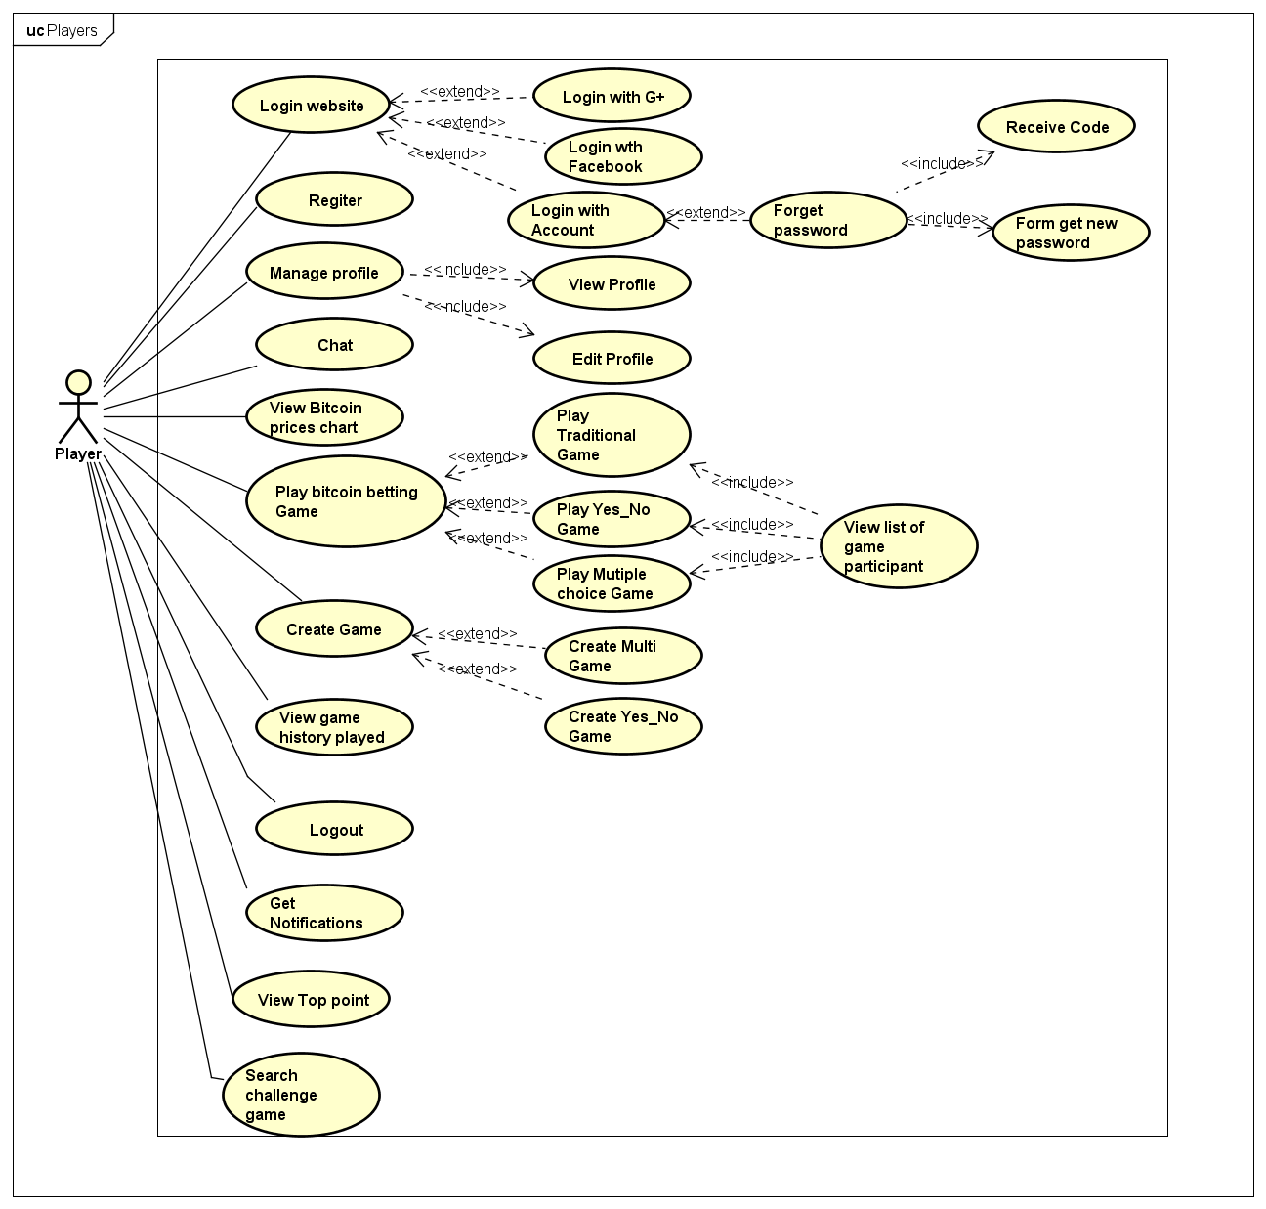
1
Introduction
2
Project management
3
Demo - Q&A
Requirement specification
4
Software Design
5
Testing
6
Limitations
7
Lesson learned
8
Functional requirements
User case level 2-Player

Slide 31
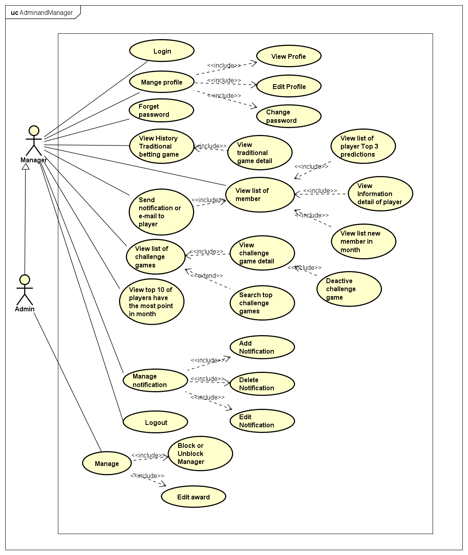
1
Introduction
2
Project management
3
Demo - Q&A
Requirement specification
4
Software Design
5
Testing
6
Limitations
7
Lesson learned
8
Functional requirements
User case level 2-Admin and Manager

Slide 32
1
Introduction
2
Project management
3
Demo - Q&A
Requirement specification
4
Software Design
5
Testing
6
Limitations
7
Lesson learned
8
Non – functional requirements
Usability
- User interface should be clear and easy to user.
- User need medium 10 minutes to learn how to use the application
- User need medium 10 minutes to learn how to use manager page, admin page.
Reliability
All inputs are validated to make sure of data that format be correct
Close all transactions from clients 10 seconds before the game ends to process system correctly
User Interface
- User interface for application must be simple and clear to be suitable for project’s target customer
Security
Secure user accounts on Player page, Admin page and Manage page
Minimize cheating

Slide 33
1
Introduction
2
Project management
3
Demo - Q&A
Requirement specification
4
Software Design
5
Testing
6
Limitations
7
Lesson learned
8
System Architecture
Base Component
Database Design
Interface design

Slide 34
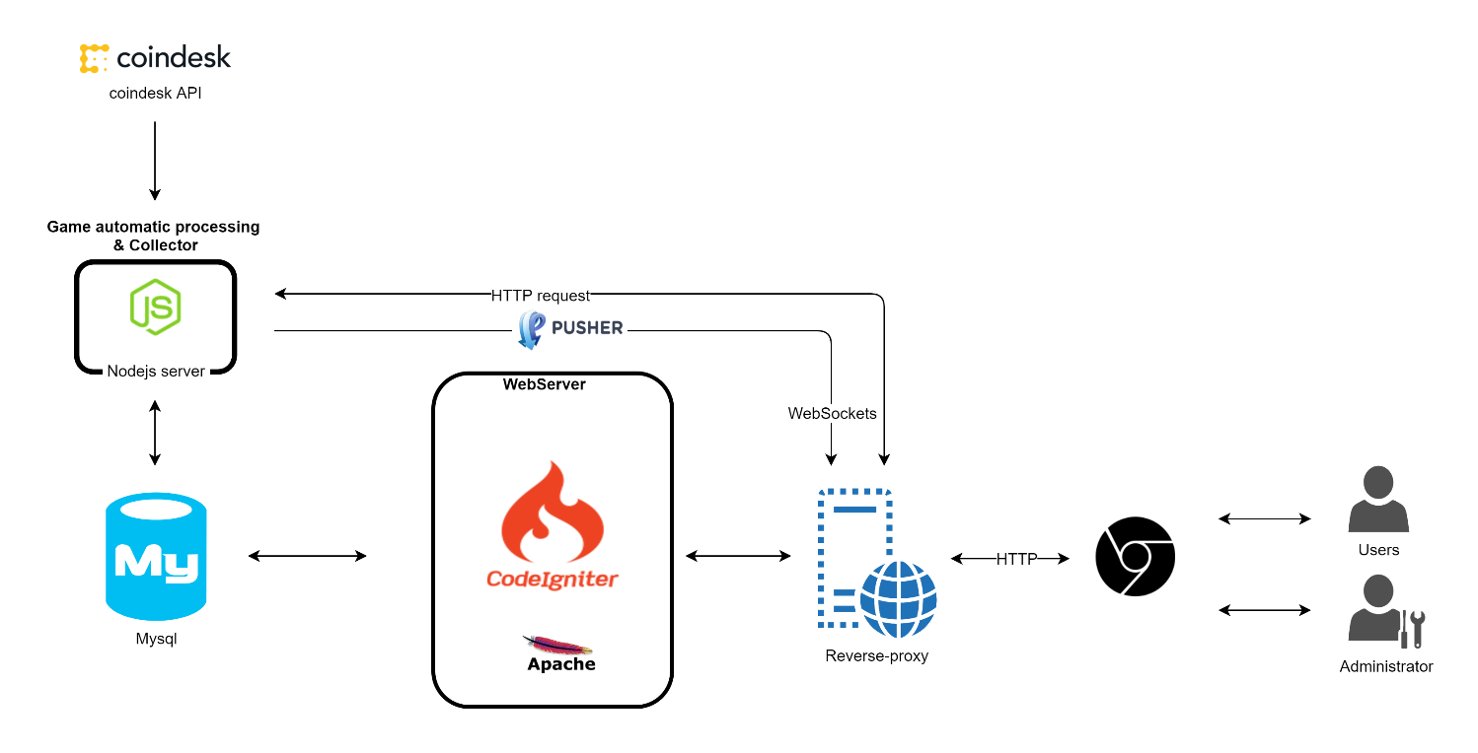
1
Introduction
2
Project management
3
Demo - Q&A
Requirement specification
4
Software Design
5
Testing
6
Limitations
7
Lesson learned
8
System Architecture

Slide 35
1
Introduction
2
Project management
3
Demo - Q&A
Requirement specification
4
Software Design
5
Testing
6
Limitations
7
Lesson learned
8
Base Component

Slide 36
View
Controllers
Model
Admin
Admin
Admin
Block
Unblock
Change gift
Block
Unblock
Change gift
Block
Unblock
Change gift
Manager
Manager
Manager
ChangeGift
Change Manager
Change Password
ChangeGift
Change Manager
Change Password
ChangeGift
Change Manager
Change Password
Create Game
Culture Game
Culture GameDetail
Create Game
Culture Game
Culture GameDetail
Create Game
Culture Game
Culture GameDetail
Edit Manager Info
Edit Notification
Forgot Password
Edit Manager Info
Edit Notification
Forgot Password
Edit Manager Info
Edit Notification
Forgot Password
MySQL
GameDetail
Home
Login
GameDetail
Home
Login
GameDetail
Home
Login
Manager Info
notification
Manager Info
notification
Manager Info
notification
Player
Player
Player
GameCT
Login
addUser
history
game
user
UserCT
home
search

Slide 37
1
Introduction
2
Project management
3
Demo - Q&A
Requirement specification
4
Software Design
5
Testing
6
Limitations
7
Lesson learned
8
Database Design

Slide 38
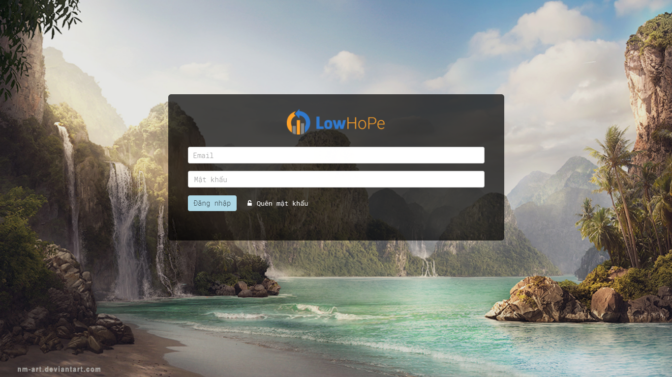
1
Introduction
2
Project management
3
Demo - Q&A
Requirement specification
4
Software Design
5
Testing
6
Limitations
7
Lesson learned
8
Interface design
MANAGEMENT

Slide 39
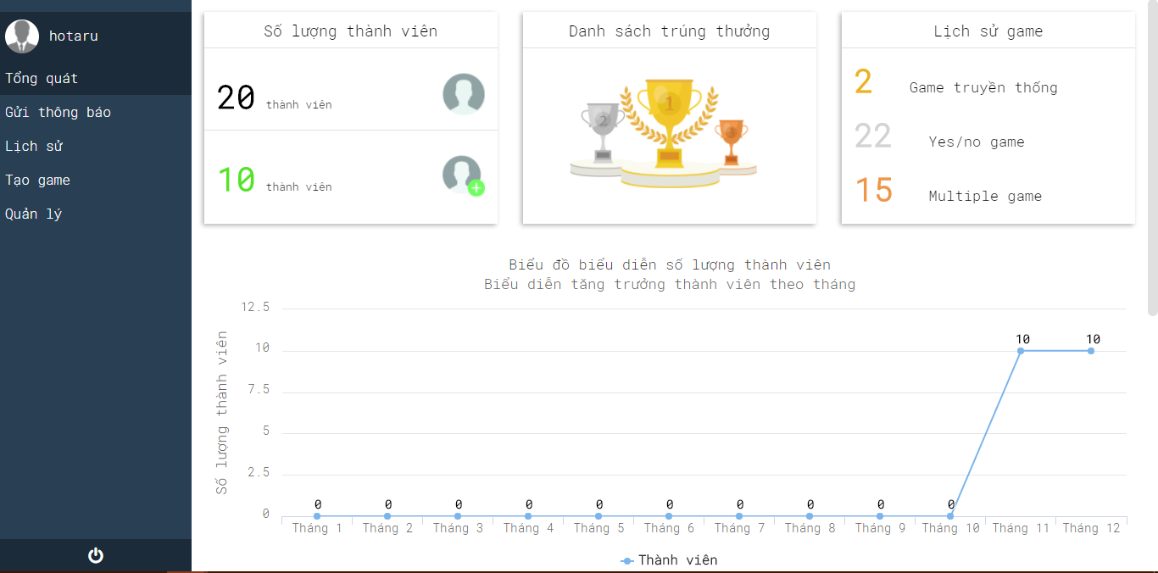
1
Introduction
2
Project management
3
Demo - Q&A
Requirement specification
4
Software Design
5
Testing
6
Limitations
7
Lesson learned
8
Interface design
MANAGEMENT

Slide 40
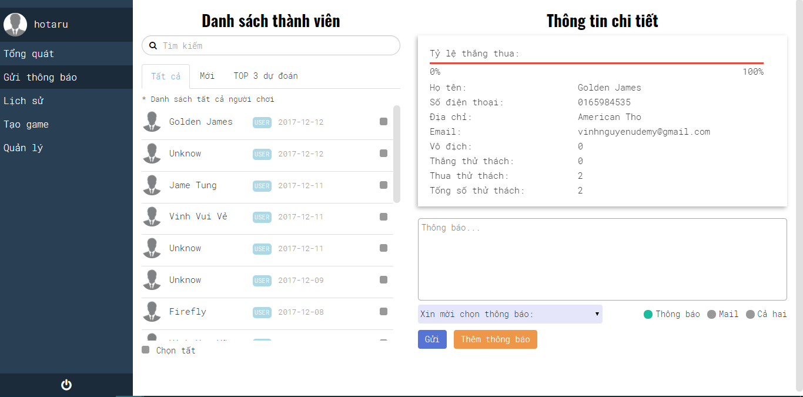
1
Introduction
2
Project management
3
Demo - Q&A
Requirement specification
4
Software Design
5
Testing
6
Limitations
7
Lesson learned
8
Interface design
MANAGEMENT

Slide 41
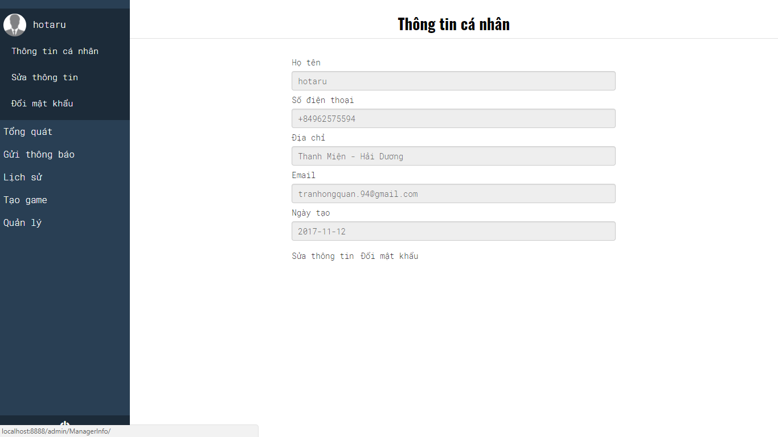
1
Introduction
2
Project management
3
Demo - Q&A
Requirement specification
4
Software Design
5
Testing
6
Limitations
7
Lesson learned
8
Interface design
MANAGEMENT

Slide 42
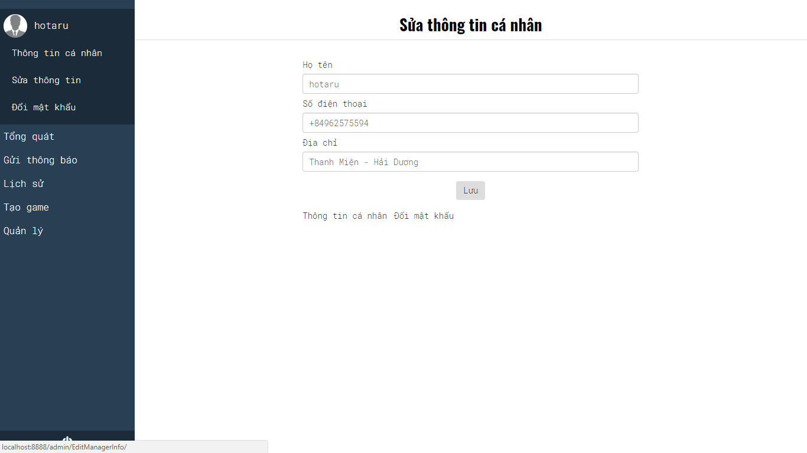
1
Introduction
2
Project management
3
Demo - Q&A
Requirement specification
4
Software Design
5
Testing
6
Limitations
7
Lesson learned
8
Interface design
MANAGEMENT

Slide 43
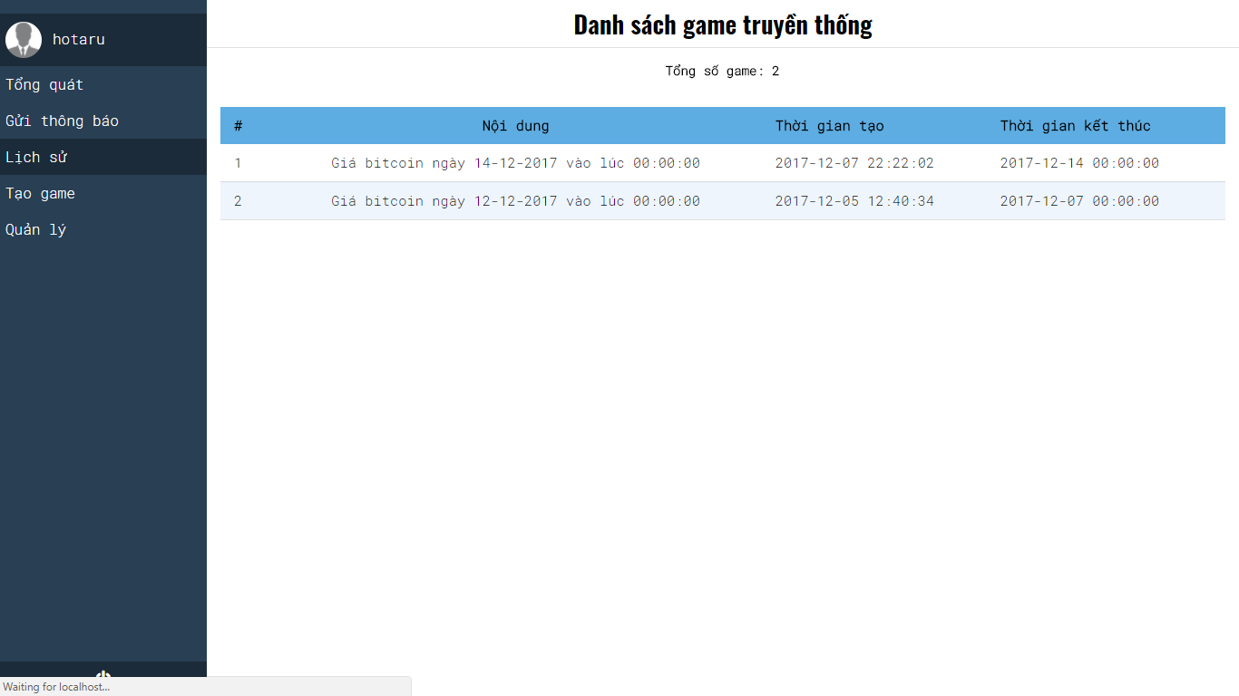
1
Introduction
2
Project management
3
Demo - Q&A
Requirement specification
4
Software Design
5
Testing
6
Limitations
7
Lesson learned
8
Interface design
MANAGEMENT

Slide 44
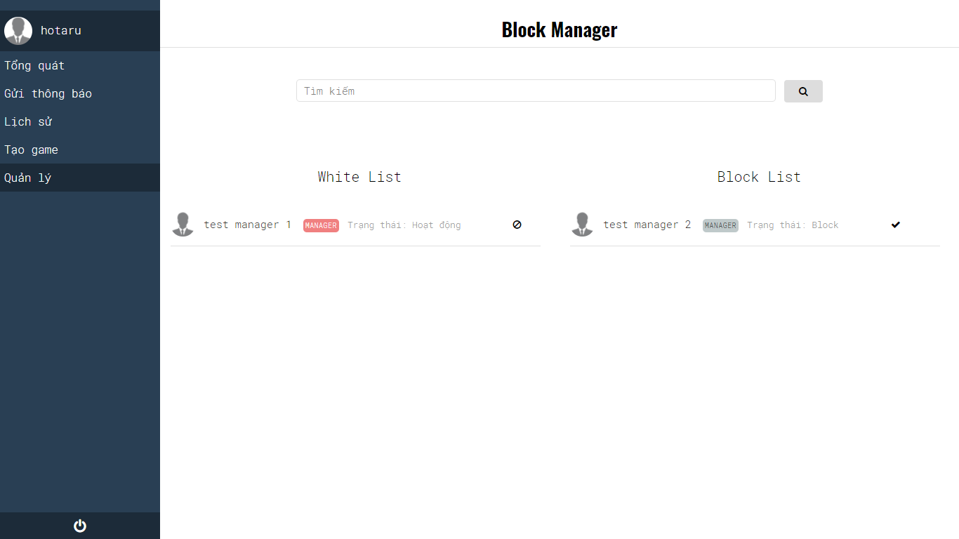
1
Introduction
2
Project management
3
Demo - Q&A
Requirement specification
4
Software Design
5
Testing
6
Limitations
7
Lesson learned
8
Interface design
MANAGEMENT

Slide 45
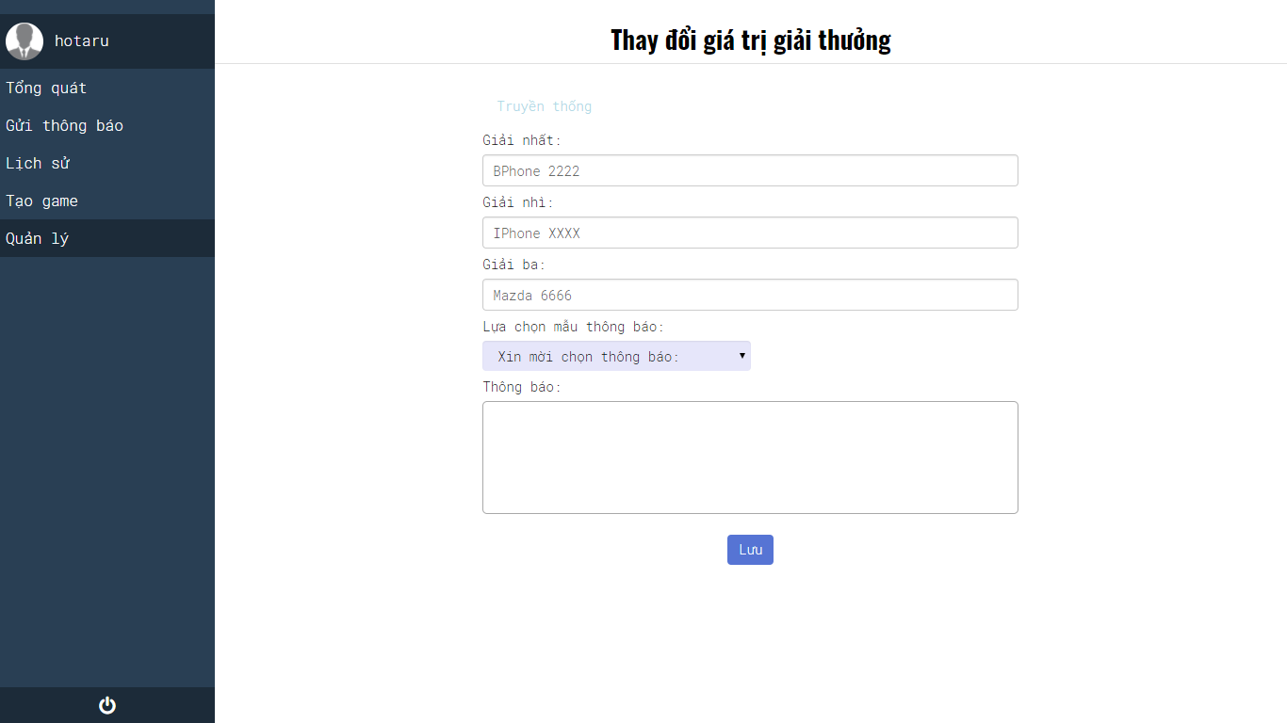
1
Introduction
2
Project management
3
Demo - Q&A
Requirement specification
4
Software Design
5
Testing
6
Limitations
7
Lesson learned
8
Interface design
MANAGEMENT

Slide 46
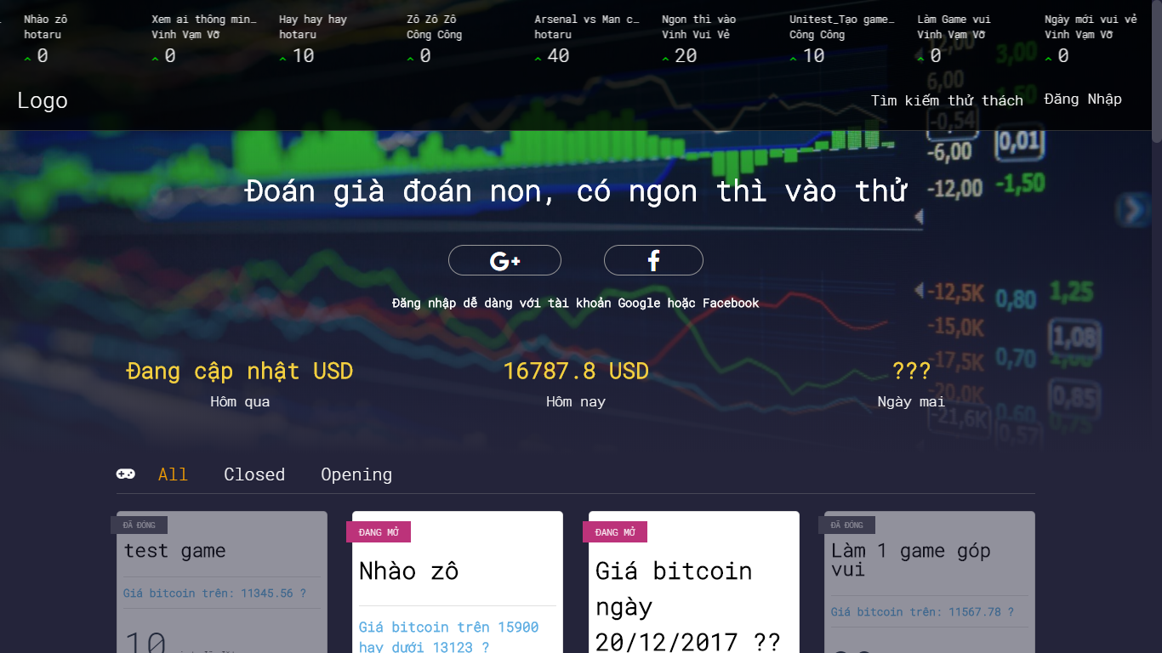
1
Introduction
2
Project management
3
Demo - Q&A
Requirement specification
4
Software Design
5
Testing
6
Limitations
7
Lesson learned
8
Interface design
PLAYER

Slide 47
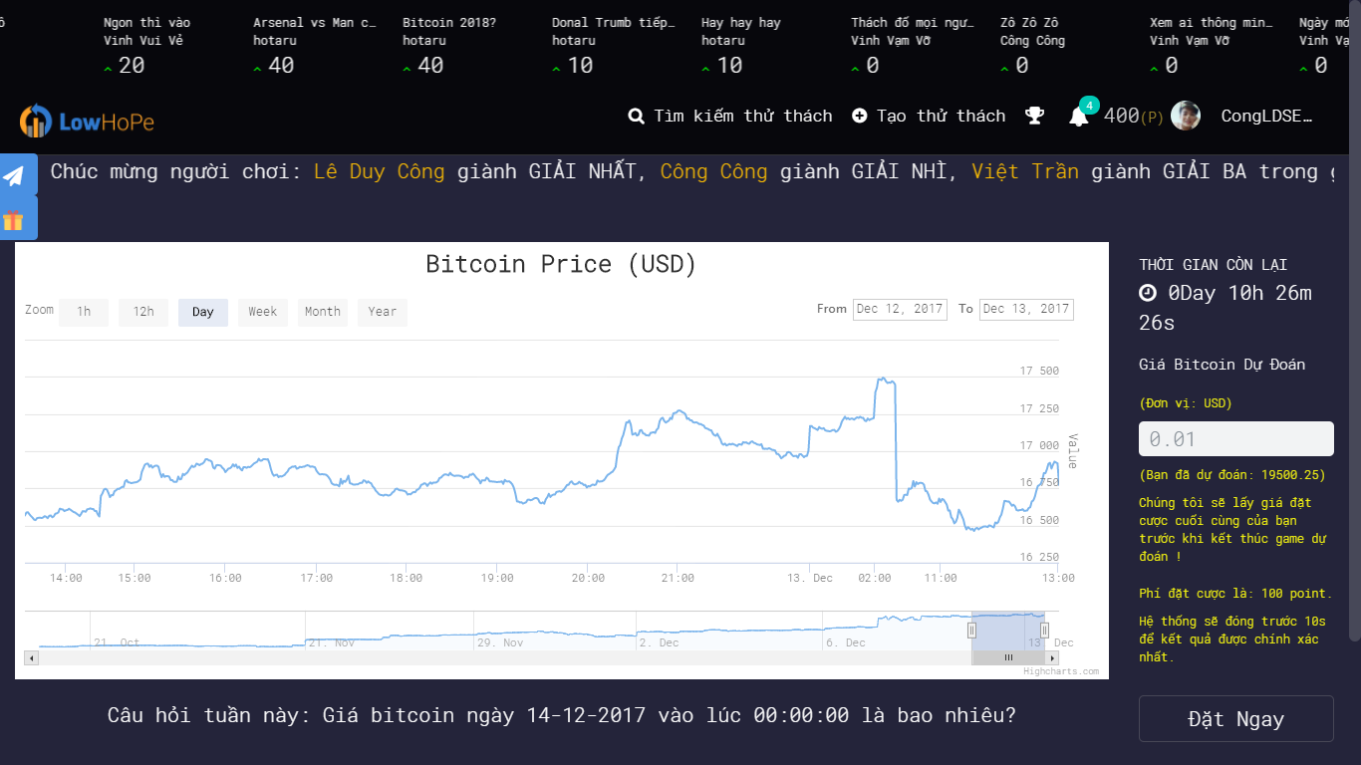
1
Introduction
2
Project management
3
Demo - Q&A
Requirement specification
4
Software Design
5
Testing
6
Limitations
7
Lesson learned
8
Interface design
PLAYER

Slide 48
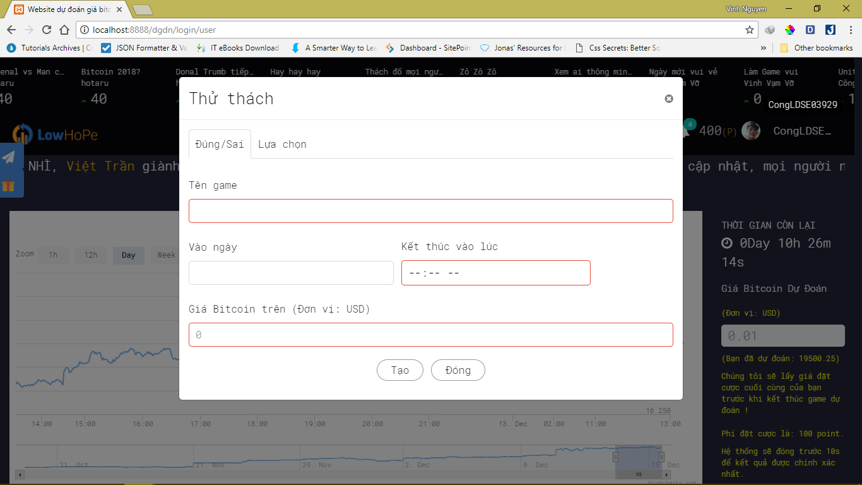
1
Introduction
2
Project management
3
Demo - Q&A
Requirement specification
4
Software Design
5
Testing
6
Limitations
7
Lesson learned
8
Interface design
PLAYER

Slide 49
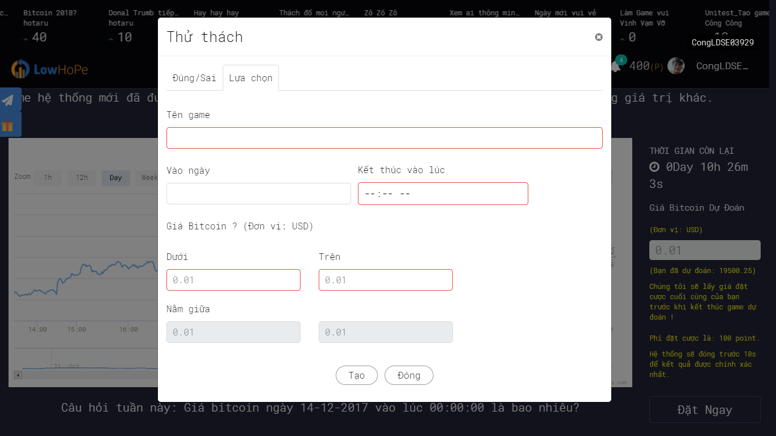
1
Introduction
2
Project management
3
Demo - Q&A
Requirement specification
4
Software Design
5
Testing
6
Limitations
7
Lesson learned
8
Interface design
PLAYER

Slide 50
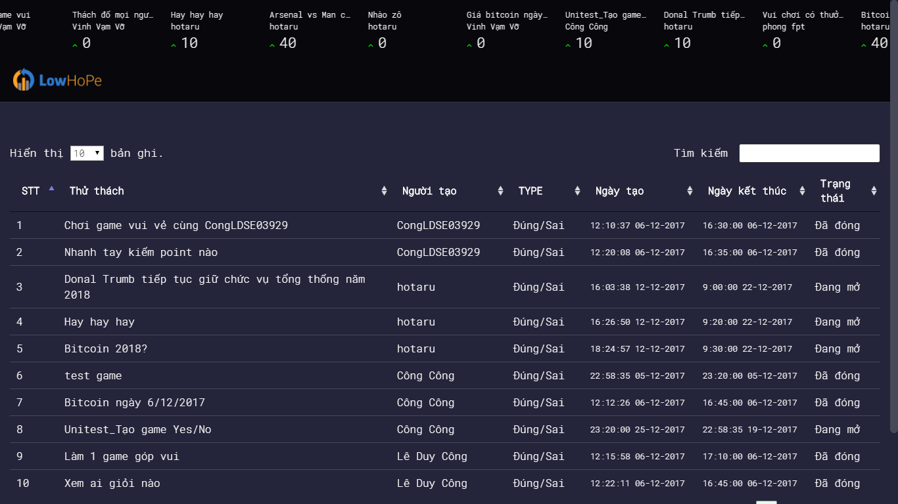
1
Introduction
2
Project management
3
Demo - Q&A
Requirement specification
4
Software Design
5
Testing
6
Limitations
7
Lesson learned
8
Interface design
PLAYER

Slide 51
1
Introduction
2
Project management
3
Demo - Q&A
Requirement specification
4
Software Design
5
Testing
6
Limitations
7
Lesson learned
8
Test process
Test environment
Test stages
Test report

Slide 52
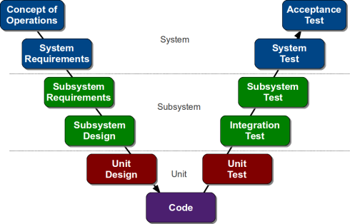
1
Introduction
2
Project management
3
Demo - Q&A
Requirement specification
4
Software Design
5
Testing
6
Limitations
7
Lesson learned
8
Test process

Slide 53
1
Introduction
2
Project management
3
Demo - Q&A
Requirement specification
4
Software Design
5
Testing
6
Limitations
7
Lesson learned
8
Test environment
- Manual test
- Asus X550LC-XX105D/ i5 -4200U/4Gb/500Gb/VGA 2GB
- Laptop Asus K451LA 54214G50W8/4210U, 1.70 GHz, 4GB
- Hardware
Dell Inspiron 14-3420 Core i3-3110
- Asus X550LC-XX105D/ i5 -4200U/4Gb/500Gb/VGA 2GB
- Hardware
Google chrome 62.0.3202.94

Slide 54
1
Introduction
2
Project management
3
Demo - Q&A
Requirement specification
4
Software Design
5
Testing
6
Limitations
7
Lesson learned
8
Test environment
- Manual test
- Google chrome version 62.0.3202.94
- Hardware
- Mozilla Firefox version 57.0.2 (64-bit)
- Microsoft Word 2013
- Hardware
- Microsoft Excel 2013

Slide 55
1
Introduction
2
Project management
3
Demo - Q&A
Requirement specification
4
Software Design
5
Testing
6
Limitations
7
Lesson learned
8
Test stages
Unit Test
Integration Test
System Test
Subsystem Test
Acceptance Test

Slide 56
1
Introduction
2
Project management
3
Demo - Q&A
Requirement specification
4
Software Design
5
Testing
6
Limitations
7
Lesson learned
8
Technical limitation
Small area of operation
Not yet support customer payment Online orders

Slide 57
1
Introduction
2
Project management
3
Demo - Q&A
Requirement specification
4
Software Design
5
Testing
6
Limitations
7
Lesson learned
8
Working in group:
Communication
Resolve conflicts
Management skills:
Organize
Negotiate
Planning
Making Decision
New technologies:
php codeigniter
jquery
Boostrap
NodeJS

Slide 58
1
Introduction
2
Project management
3
Demo - Q&A
Requirement specification
4
Software Design
5
Testing
6
Limitations
7
Lesson learned
8
THANKS FOR LISTENING

